Slide 1
Status of Countries
VISUALIZATION

Slide 2
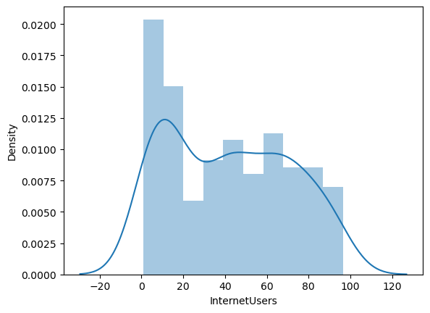
InternetUsers
Country status can be determined by number of people using internet.
Here we visualized using seaborn which is an advanced visulization library based on matplotlib.
Internet user ranges
from 1 to 96
Higher density of internet
is used by only range from
10 to 15.

Slide 3
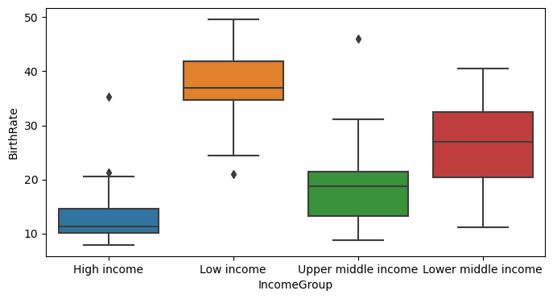
IncomeGroup & BirthRate
We use boxplot visualization on IncomeGroup and BirthRate attributes.
Boxplot visualization is bivariate distribution.
sns.boxplot(data = stats, x="IncomeGroup", y='BirthRate')
Some facts:-
There are three outliers detected in High, Low, Upper middle income categories of IncomeGroup.
Low Income category has
high birthrate percent this
can known by observing
mean line of the individual
category.

Slide 4
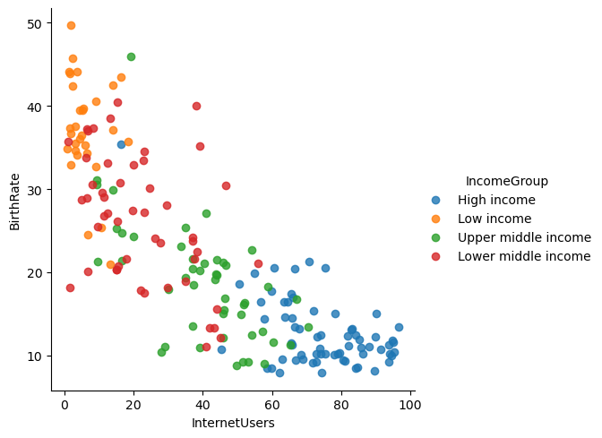
InternetUsers & BirthRate
Here LM (Linear Model) visualization is done on the InternetUsers and BirthRate attributes based on the Incomegroup category.
sns.lmplot(data = data,x = 'InternetUsers', y = 'BirthRate',
fit_reg = True,hue = 'IncomeGroup‘)
Some Facts:-
High IncomeGroup category has low Birthrate and they are High InternetUsers.
Low IncomeGroup category
has high Birthrate and they
are low InternetUsers.

